Slide 1

HUM 102 Report Writing Skills
Lecture 08

Slide 2

Previous Lecture
Discussions
Introduction to Technical Writing (Communication)
Origin of Technical Writing
Purpose of Technical Writing
Examples of Different types of Technical Writing

Slide 3



Objectives/Traits in Technical Writing
Why are you writing
Information
Persuasion
Audience

Slide 4

Understanding Audience
Education
Subject Knowledge
Relationship with Audience

Slide 5
Objectives/Traits in Technical Writing
How to enhance the probability of comprehension for the audience?
Clarity
Conciseness
Accessible Document Design (necessary info)
Audience Recognition (specified)
Accuracy (grammar)
Easily understood by your intended audience
Clear and crisp
All of the necessary information is present
Audience is specified
Grammatical correct and accurate

Slide 6

Objectives/Traits in Technical Writing
How to enhance the probability of comprehension for the audience?
Clarity
Conciseness
Accessible Document Design (necessary info)
Audience Recognition (specified)
Accuracy (grammar)

Slide 7


Clarity
Avoid ambiguity
Prefer the active voice
Exclude personal introduction and conclusion
Use transition words

Slide 8


Clarity
Avoid ambiguity
Prefer the active voice
Exclude personal introduction and conclusion
Use transition words
Ambiguous: “Our patients enjoy the warm days while they last.”
Clear: “While the warm days last, our patients enjoy them.”

Slide 9

Clarity
Avoid ambiguity
Prefer the active voice
Exclude personal introduction and conclusion
Use transition words
Ambiguous: “Our patients enjoy the warm days while they last.”
Clear: “While the warm days last, our patients enjoy them.”

Slide 10
Clarity
Avoid ambiguity
Prefer the active voice [1/2]
Exclude personal introduction and conclusion
Use transition words
Passive Voice: “An inaccurate report about the university’s plans, presented by John, appeared in the media.”
Active Voice: “John gave an inaccurate report about the university’s plans to the media.”

Slide 11
Clarity
Avoid ambiguity
Prefer the active voice [1/2]
Exclude personal introduction and conclusion
Use transition words
Passive Voice: “An inaccurate report about the university’s plans, presented by John, appeared in the media.”
Active Voice: “John gave an inaccurate report about the university’s plans to the media.”

Slide 12
Clarity
Avoid ambiguity
Prefer the active voice [2/2]
Exclude personal introduction and conclusion
Use transition words
Passive Verbs: “The experiment was conducted so that the relationship between the two theories could be examined.”
Active Verbs: “The experiment examined the relationship between the two theories.”

Slide 13
Clarity
Avoid ambiguity
Prefer the active voice [2/2]
Exclude personal introduction and conclusion
Use transition words
Passive Verbs: “The experiment was conducted so that the relationship between the two theories could be examined.”
Active Verbs: “The experiment examined the relationship between the two theories.”

Slide 14
Clarity
Avoid ambiguity
Prefer the active voice
Exclude personal introduction and conclusion
Use transition words
Don’t Write: “In my opinion, you can easily forget how different life was 50 years ago.”
Write: “It is easy to forget how difficult life was 50 years ago.”

Slide 15
Clarity
Avoid ambiguity
Prefer the active voice
Exclude personal introduction and conclusion
Use transition words
Don’t Write: “In my opinion, you can easily forget how different life was 50 years ago.”
Write: “It is easy to forget how difficult life was 50 years ago.”

Slide 16

Clarity
Avoid ambiguity
Prefer the active voice
Exclude personal introduction and conclusion
Use transition words
To combine thoughts between sentences for making the flow smoother and the switching of idea less abrupt.
However
Therefore
Although
Furthermore
Nevertheless
Likewise
Alternatively
Consequently

Slide 17
Clarity
Avoid ambiguity
Prefer the active voice
Exclude personal introduction and conclusion
Use transition words
Wrong: “Student should be on time and they should be prepared as well.”
Correct: “Students should be on time. Furthermore, they must be prepared. ”

Slide 18
Clarity
Avoid ambiguity
Prefer the active voice
Exclude personal introduction and conclusion
Use transition words
Wrong: “Student should be on time and they should be prepared as well.”
Correct: “Students should be on time. Furthermore, they must be prepared. ”

Slide 19
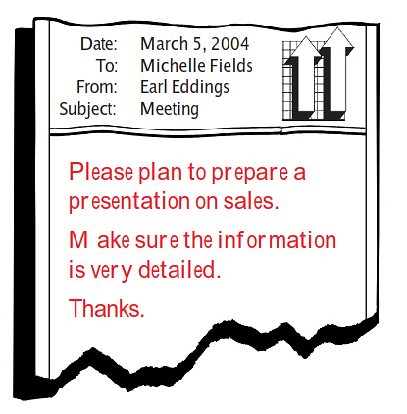

Sample: This flawed memo, written by a manager to a newly hired employee, highlights the importance of clarity…
Writing that Works: A Teacher's Guide to Technical Writing by Steven M. Gerson, page 11.
Reference

Slide 20

Check List
Who is the audience? Who will know what? Will the audience know a great deal (High Tech)? Will the audience know a little about the topic (Low Tech)? Will the audience know nothing about the topic (Lay)?
What do you plan to do? What do you want the audience to do? What do you want to know?
When should the job be completed? What’s the turnaround time? What’s the timetable? What’s the desired schedule? When do you need an answer?
Where will the work take place?
Why is the task being undertaken (the rationale, motivation, goal)? Why is the desired date important?
How should the task be performed? What’s the preferred procedure?

Slide 21
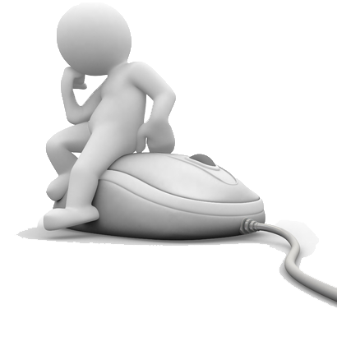

Stop and Think!!!
Using the checklist as pre-writing tool, revise the previous memo to achieve improved clarity.

Slide 22
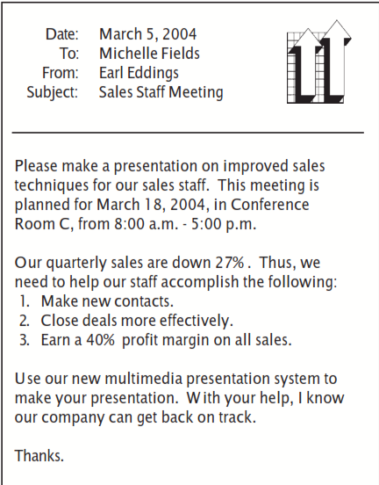

Suggested Solution

Slide 23
Objectives/Traits in Technical Writing
How to enhance the probability of comprehension for the audience?
Clarity
Conciseness
Accessible Document Design (necessary info)
Audience Recognition (specified)
Accuracy (grammar)

Slide 24
Objectives/Traits in Technical Writing
How to enhance the probability of comprehension for the audience?
Clarity
Conciseness
Accessible Document Design (necessary info)
Audience Recognition (specified)
Accuracy (grammar)

Slide 25

Conciseness
Write positively
Paragraph often
Use reasonable sentence length
Delete meaningless words
Delete doubled words
Delete redundant categories
Reduce phrases to words

Slide 26


Conciseness
Write positively
It usually takes more words to convey the same idea in a negative form than in a positive form.
Paragraph often
Paragraph often to break up complex text.
A good thumb rule is 60-100 words for an average paragraph.

Slide 27
Conciseness
Use reasonable sentence length
Keep sentences short so that readers don’t have to remember too much information to understand the sentence.
Most sentences average 20 words.
If a sentence is exceeding 40 words, try to find a way to break it up into smaller sentences.

Slide 28
Conciseness
Use reasonable sentence length
Wrong: “In order to successfully accomplish their job functions, the team has been needing more work space for sometime now.”
Correct: “The team needs more work space to do its jobs.”

Slide 29
Conciseness
Use reasonable sentence length
Wrong: “In order to successfully accomplish their job functions, the team has been needing more work space for sometime now.”
Correct: “The team needs more work space to do its jobs.”

Slide 30


Conciseness
Use reasonable sentence length
You can shorten sentence by avoiding
Redundancy
Prepositional phrases
Passive voice

Slide 31
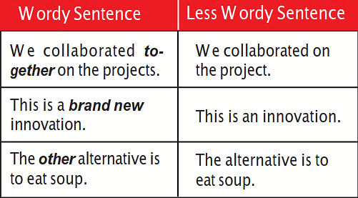

Conciseness
Use reasonable sentence length
Avoiding redundancies: some scenarios

Slide 32
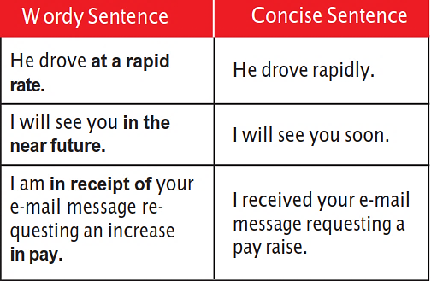
Conciseness
Use reasonable sentence length
Avoiding prepositional phrases: some scenarios

Slide 33
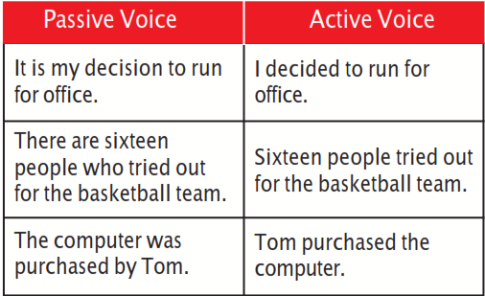
Conciseness
Use reasonable sentence length
Avoiding passive voice: some scenarios

Slide 34

Conciseness
Delete meaningless words
Avoid words that do not add any meaning to a sentence
Basically
Generally
Kind of
Actually

Slide 35
Conciseness
Delete meaningless words
Wrong: “The picture was kind of blurry.”
Correct: “The picture was blurry.”

Slide 36
Conciseness
Delete meaningless words
Wrong: “The picture was kind of blurry.”
Correct: “The picture was blurry.”

Slide 37
Conciseness
Delete doubled words
Do not use word pairs that mean the same thing
Goals and objectives
First and foremost
Basic and fundamental
Hopes and desires
Each and every
Fully and completely
One and the same
Ways and means

Slide 38


Conciseness
Deleting redundant categories
Round in shape
Large in size
Blue in color
Heavy in weight
Sour in taste
Shiny in appearance
Smooth in texture
Honest in character

Slide 39

Conciseness
Reduce phrases to words
Many phrases can be expressed in fewer words or even in a single word.
For this reason ➔ so
Due to the fact that ➔ because
At a much greater rate than ➔ faster
Despite the fact that ➔ although
A great deal of ➔ much

Slide 40

Objectives/Traits in Technical Writing
How to enhance the probability of comprehension for the audience?
Clarity
Conciseness
Accessible Document Design (necessary info)
Audience Recognition (specified)
Accuracy (grammar)

Slide 41
Conclusions
Traits in technical writing
Clarity
Conciseness

